Slide 1

Cyber Security
Application of Information & Communication Technology
About us: JAHAN ZAIB SIBGHA ZAMEER WALEED AHMED FIZA TAHIR

Slide 2
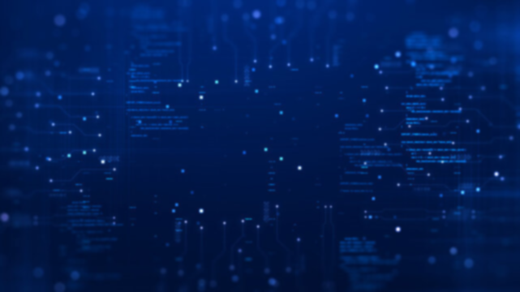
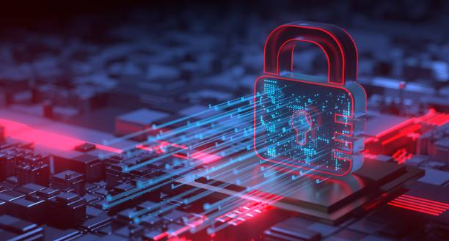
Cyber Security
Introduction:
Cybersecurity is the practice of protecting internet-connected systems such as hardware, software and data from cyber threats.
Types:
There are many types of Cyber Securities like Application Security, Data Security, Cloud Security, Mobile Security, Network Security.

Slide 3
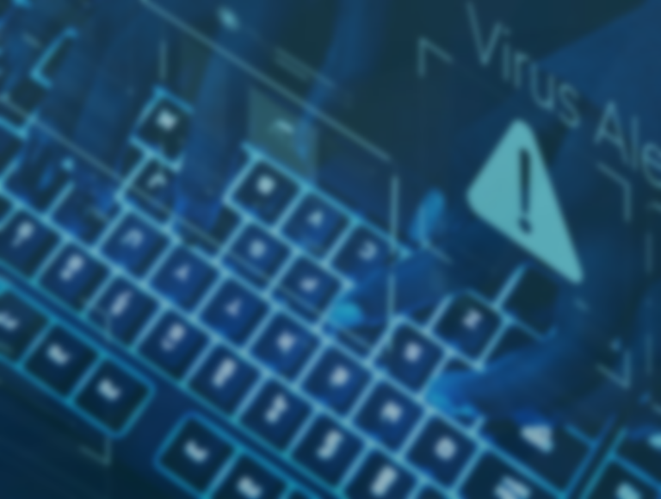
Cyber Security
Attack types | Description
Malware | Software designed to harm or gain unauthorized access.
Phishing | Deceptive techniques to trick users into revealing info.
DoS and DDoS Attacks | Overwhelm systems with excessive traffic.
Data breaches | Unauthorized access to sensitive data.
Insider threats | Threats from within an organization.
Spyware | Software that Secretly gathers information about a person or organization without their consent or knowledge.
Ransomeware | Software that encrypts files or locks a device, demanding payment for their release.

Slide 4
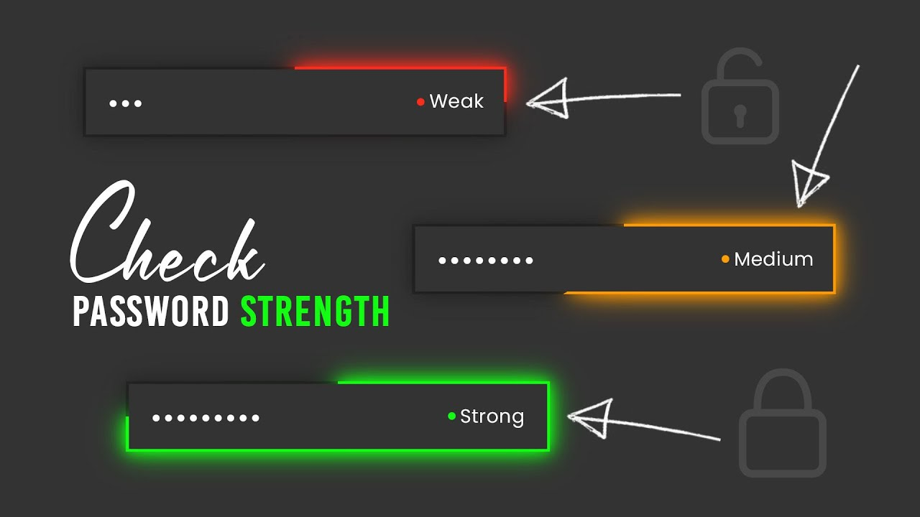
PASSWORD AUTHORIZER
What is Password Authorizer?
Password authorizer is a tool that takes password form user and tell whether the password is weak or strong. It is used to evaluate the effectiveness of password by analyzing various aspects of a password, such as length, complexity, and randomness, to determine how resistant it is to hacking attempts.
Why do we use Password Authorizer?
We use password authorizer for following purposes:
Security:
Passwords are the first line of defense against unauthorized access to
accounts or systems so we use it to increase the security of our account
Education and Awareness:
Password Authorizer not only evaluate passwords but also educate users on the principles of strong password creation.
Risk Mitigation:
It is used to reduce risk against various attacks of hackers.

Slide 5
Functionality of Password Authorizer
It consist up of password input box where user can enter and check the strength of password
When user enter a strong password containing upper case letter , lower case letter , special character, 8 or more letters etc then it shows that password is strong
When user enters a weak password it shows the password is weak
It also tells what is missing in password that makes it a weak password
Password
Input box
Step 1
Step 5
Check password
strength
Step 2
Upper case letters
Lower case letters
Special characters
8 Or more
Step 3
Password strength indicator
Step 4
Display result
Strong

Slide 6
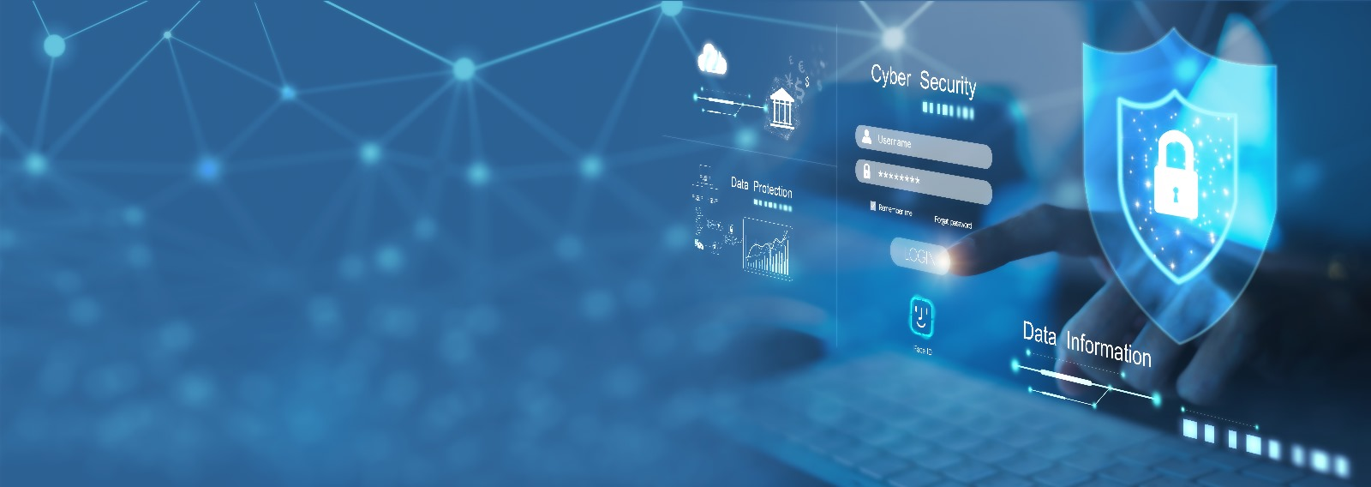
Working of Password Authorizer:
Weak Password: Indicates that the password is very easy to guess or crack.
Feedback: "Your password is weak.”
Medium Password: Indicates that the password has some level of security but could be improved.
Feedback: "Your password is medium strength."
Strong Password: Indicates that the password is sufficiently secure and resistant to common attacks.
Feedback: "Your password is strong.“
Password Length: Emphasizes the importance of having a long password.
Feedback: "Your password should be at least [8] characters long for better security."
Character Diversity: Encourages the use of a mixture of character types (uppercase letters, lowercase letters, numbers, and special characters).

Slide 7
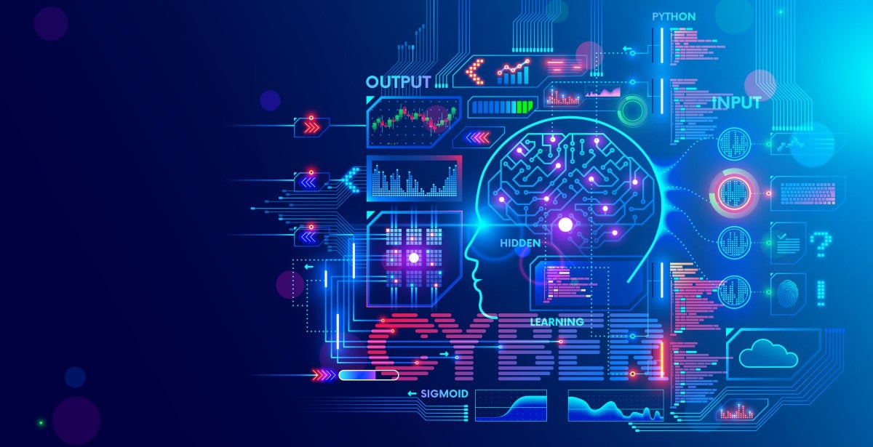
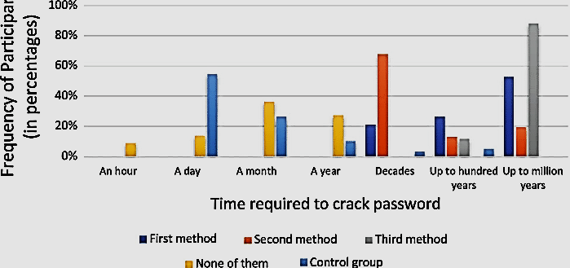
FLOW CHART: This chart shows how the strength of password affect the time required to crack the password.
Password strength
Some common password authorizer:
Kaspersky Password Checker.
PasswordMeter.com.
How Secure Is My Password.
Norton Password Generator.

Slide 8
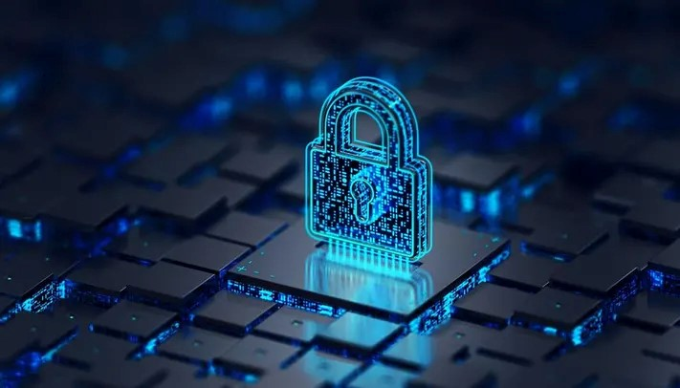
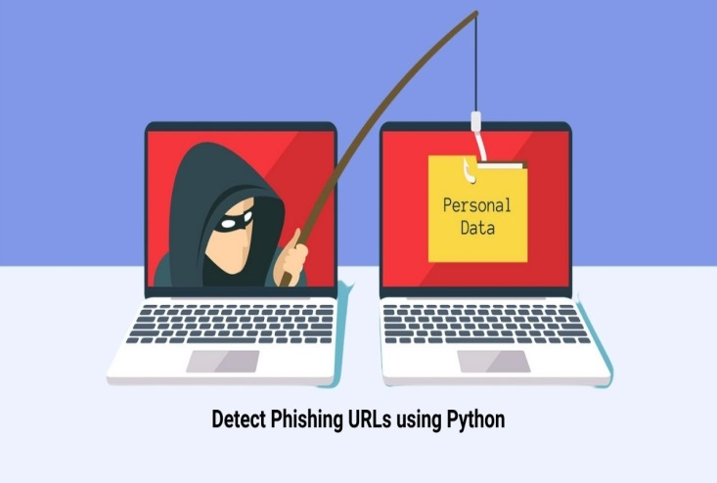
PHISHING WEBSITE
Definition: A fraudulent website designed to mimic legitimate websites, aiming to trick users into providing sensitive information.
Characteristics: Often look identical to real websites, including logos, design, and URL.
Intent: To steal personal data such as login credentials, credit card information, or other sensitive data.
WORKING:
Email or Message: Users receive emails or messages directing them to the phishing website, often posing as trusted sources like banks, social media platforms, or online retailers.
Deceptive Tactics: Phishing websites employ various tactics such as urgency (e.g., claiming an account will be suspended), fear (e.g., threat of legal action), or incentives (e.g., fake promotions) to prompt users to input their information.
Data Collection: Once users enter their information on the phishing website, it is collected by the perpetrators for malicious purposes.

Slide 9
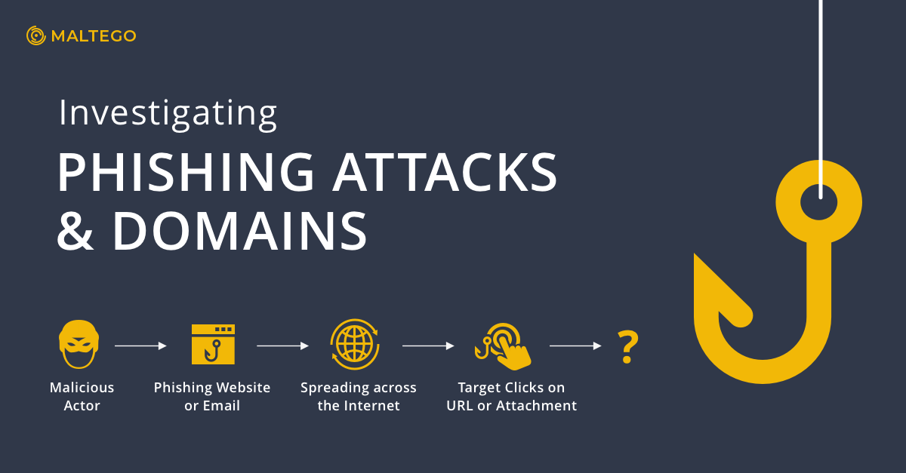
IMPACTS ON USERS:
Financial Loss: Users may suffer financial loss if their banking or credit card information is compromised.
Identity Theft: Personal information obtained through phishing can lead to identity theft, affecting users' credit scores and reputation.
Trust Erosion: Incidents of phishing erode trust in online platforms and services, impacting users' confidence in conducting online transactions

Slide 10
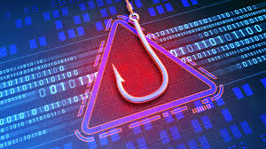
CAUSES
Lack of Awareness:
Many users are unaware of the existence and tactics of phishing websites, making them more susceptible to falling into the trap
Trust in Familiarity:
Users often trust familiar-looking websites or emails without verifying their authenticity, making it easier for phishing websites to deceive them.
Emotional Triggers:
Phishing emails often evoke emotions such as fear or excitement to prompt impulsive actions without careful consideration.
Poor Security Practices:
Users who fail to implement security measures such as multi-factor authentication or anti-phishing software are at a higher risk of falling victim to phishing attacks.

Slide 11
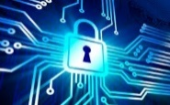
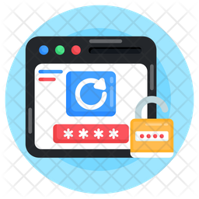
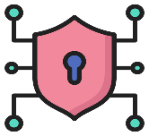
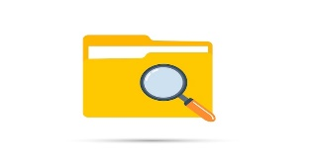
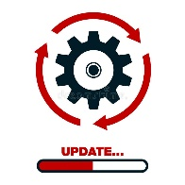
System Model:
Security measures
Step 1
Step 3
Detects weak passwords
Evaluate cyber threats and risk.
Scans suspicious files and removes it
Step2
Recommends software updates

Slide 12
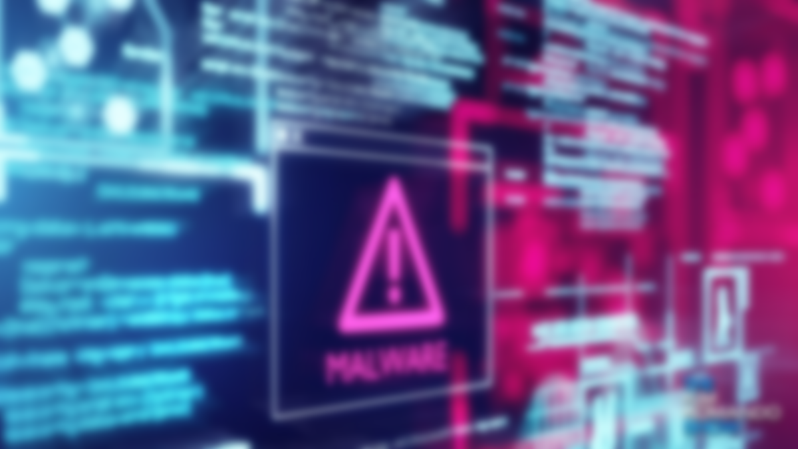
Virus Checker
A virus checker, correctly called an antivirus, is a software program that automatically search a computer file for known viruses.
Detect and prevent malicious software and viruses on your computer or laptop. An antivirus product is a program designed to detect and remove viruses and other kinds of malicious software from your computer or laptop.

Slide 13
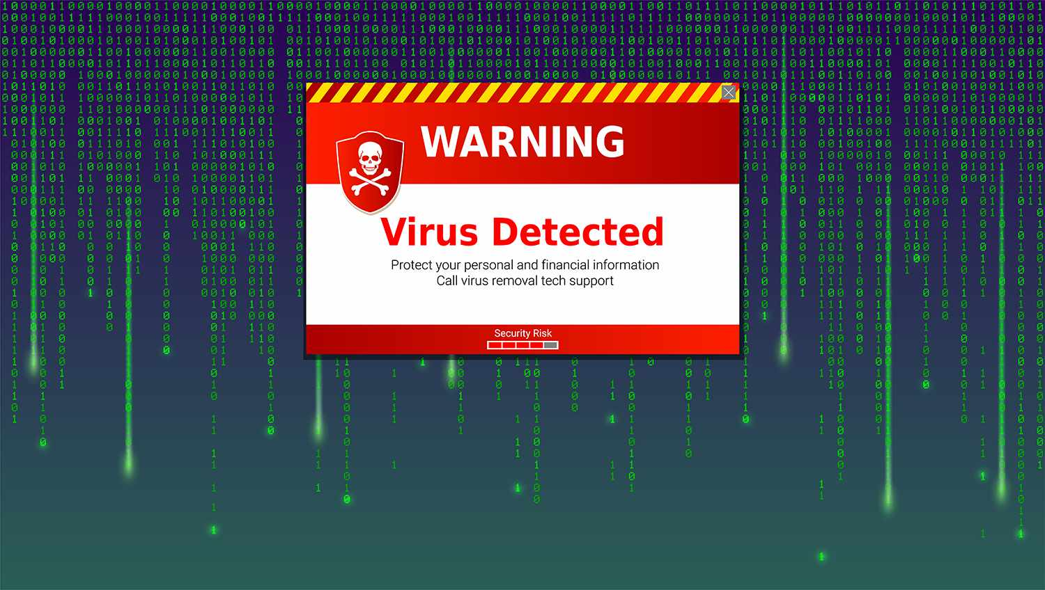
How it works?
Antivirus software usually works on one of two principles:
Either it scans programs and files as they enter your device and compares them to known viruses.
It scans programs already on your device, looking for any suspicious behavior.

Slide 14
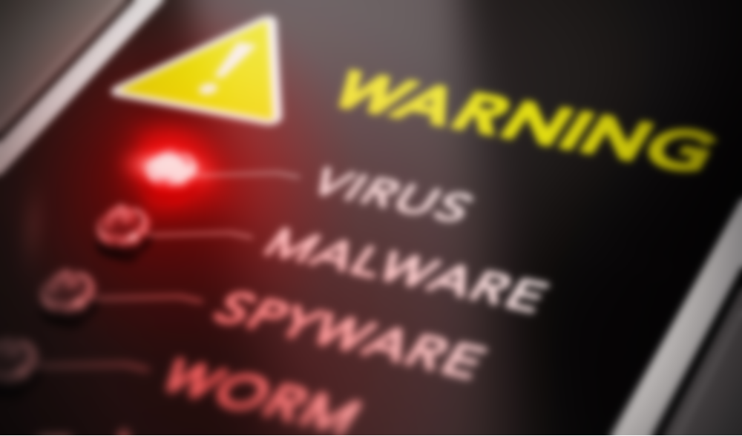
Viruses
Some types of viruses are:
Spyware
Trojan Horse
Worm Virus
DDOS Attack

Slide 15

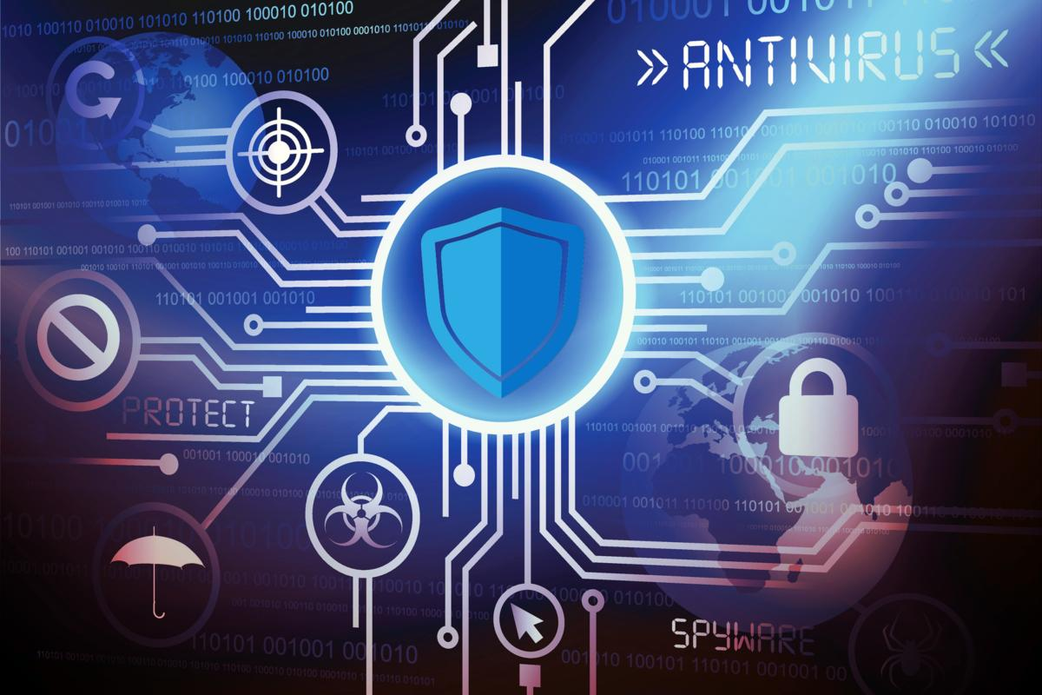
Antiviruses
Some types of Antiviruses are:
Avast
Windows Defender
McAfee
Norton

Slide 16
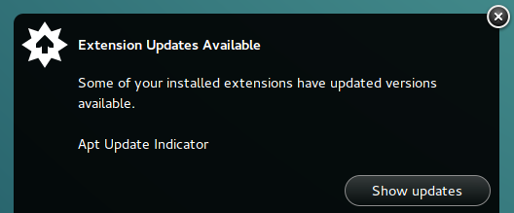
Update Notifier
An update notifier is a tool or feature within software applications or systems that alerts users when updates are available for the software.
It serves to inform users about new versions, patches, bug fixes, security updates, or feature enhancements.

Slide 17
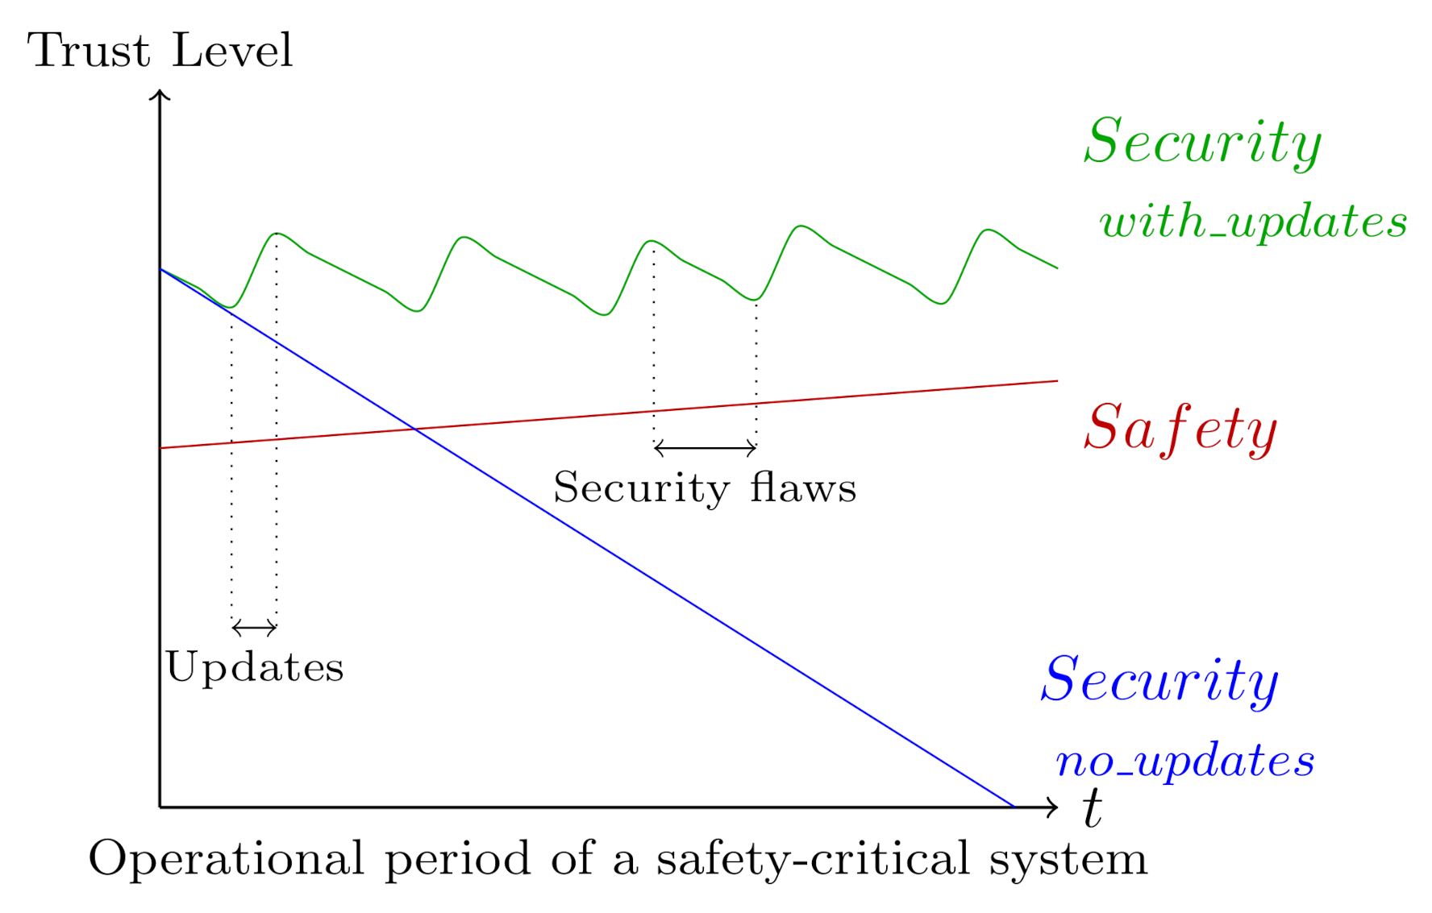
Update Notifier
Importance:
Windows Updates are often irritating to us, but they come with important security updates that are essential for the safety of its users.
If we don’t update our operating system with time, it becomes obsolete and redundant to malware attacks.
Hackers often exploit known vulnerabilities in outdated software to gain unauthorized access, or steal sensitive information.

Slide 18
Thank You!

